Slide 1
The battle of Neighborhood
Clustering districts in Paris
Seohyun PARK

Slide 2
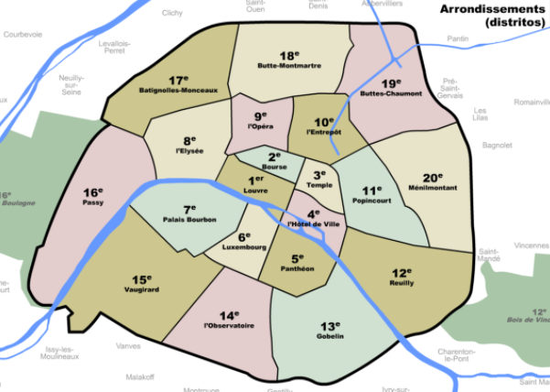
Districts in Paris

Slide 3
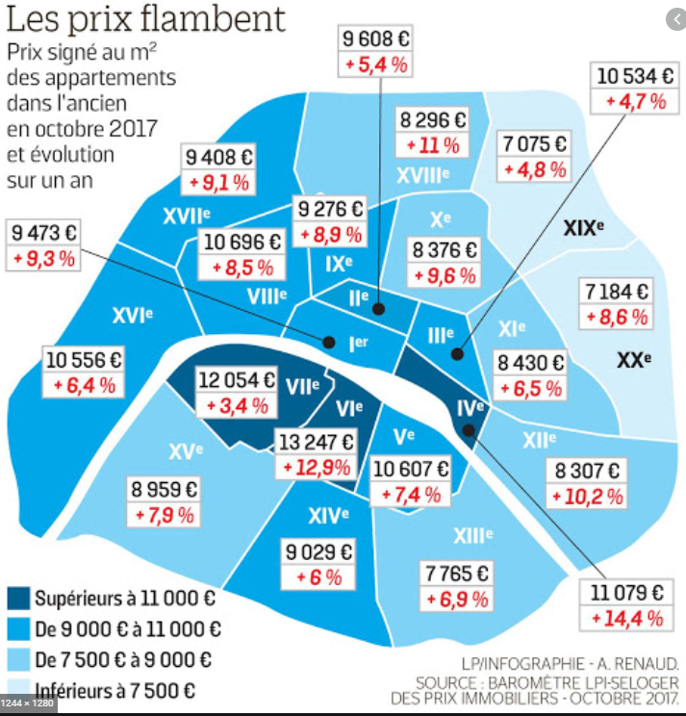
Price ?

Slide 4
Data
Open data
Scrapping

Slide 5
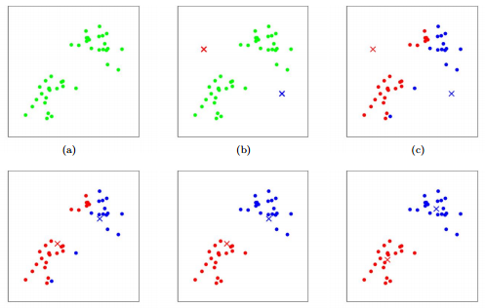
K-mean

Slide 6
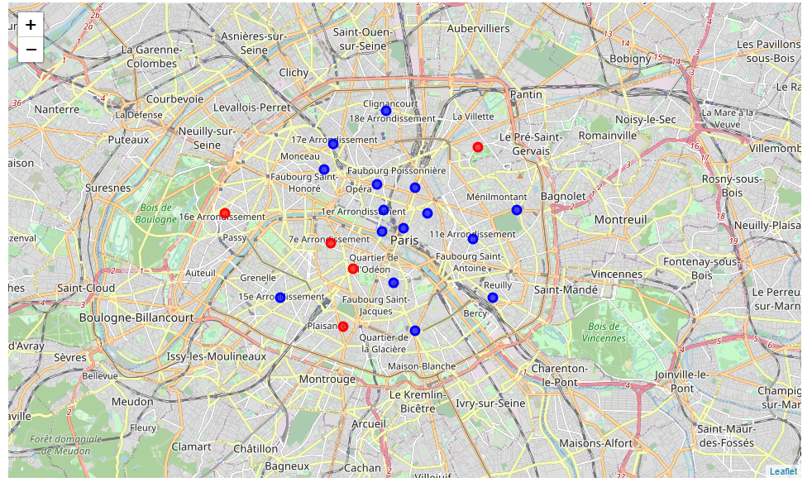
Result

Slide 7
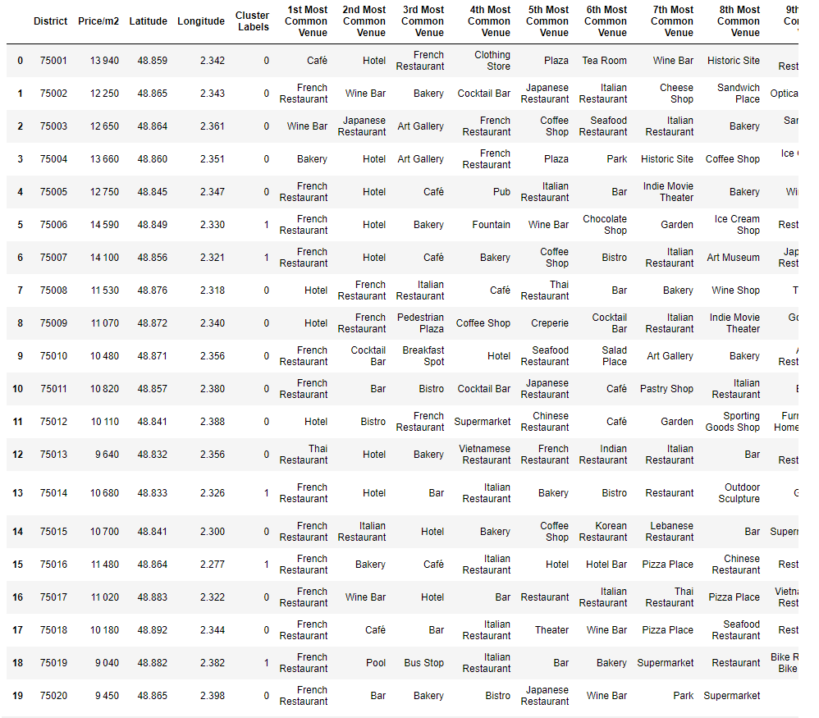
Result

Slide 8
Conclusion

